Slide 1



5e Forum 6 Nov 2015 Iasi
SMHO Water4Life project: safe drinking water for schools hospitals private people at Romania.
Alex Vrinzen
www.Water4Life.eu
Frits Herijgers
www.SMHO.nl

Slide 2





Mission water4life:
To provide safe healthy drinking water to poor people and to help the ‘Bottom Of the Pyramid‘

Slide 3
Goal:
  To provide people with an affordable option for safe healthy drinking water for schools, hospitals and households.
  To give knowledge, experience to people;
  how they can use simple techniques to create safe healthy drinking water from available water sources.
  Social Innovation: Creating products for those at the bottom of the pyramid to get a healthy fortuned (water4)life.
  Social Economy: To let them produce / assemble quality purifiers against lowest possible costs, but always with small entrepreneurs that can acquire a fair salary with it.

Slide 4

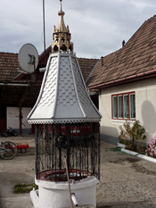
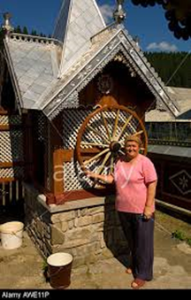
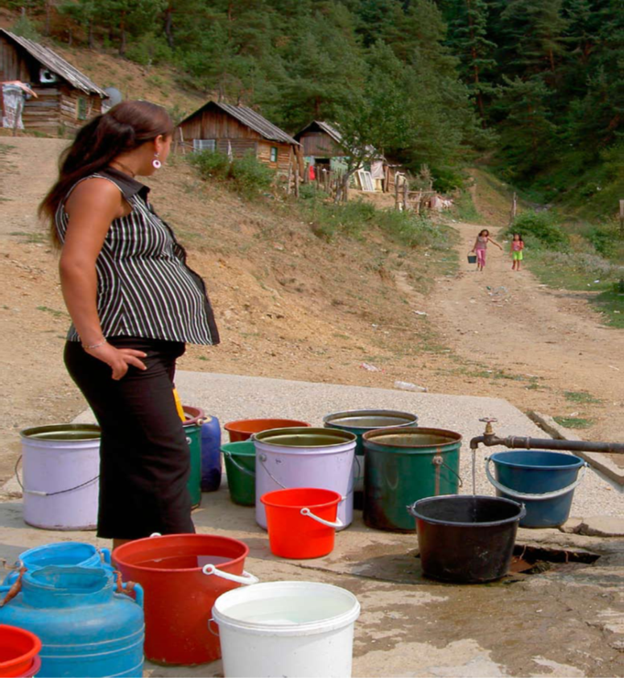
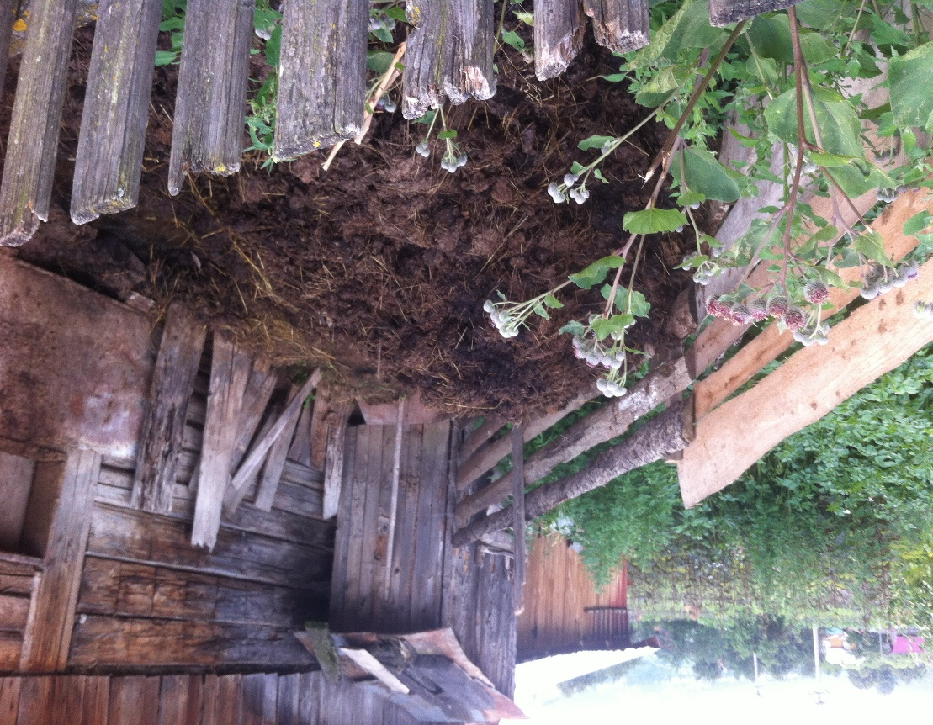
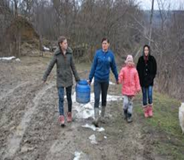
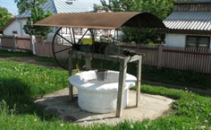
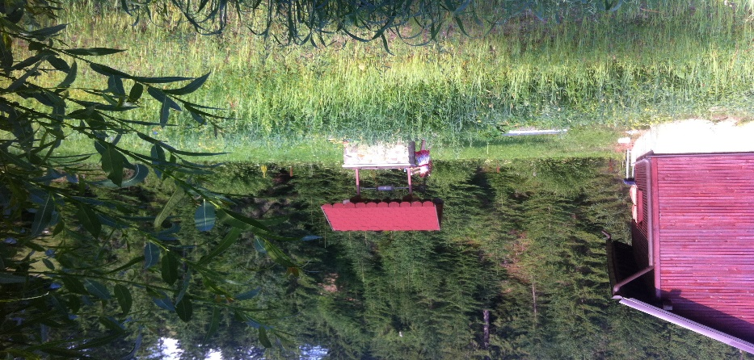
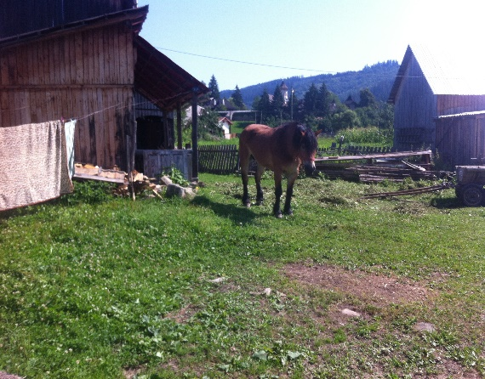
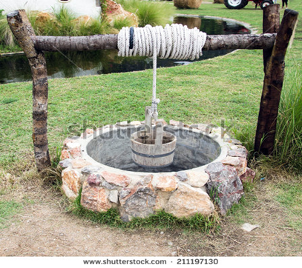
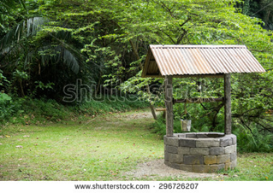
schools and/or hospitals, Vatra Moldevitei, Campulung Moldoveneac, Pojorata, Frumosu, Moldovita, Vama and Sadova.
Lot of open wells buckets or pump with(out) cover.

Slide 5
Situation mention villages Romania
Lot of open wells with buckets or pump with(out) cover leads to risks:
Contamination with bacteria leads to diarrhoea, dehydration children and elderly.
  Possibility Blue disease, nitrite formation.
      Real case farmers family at Vatra
All tubewater is chlorinated, no drinking water
No heavy metals, cadmium, lead, selenium, arsenic, mercury or chrome al below the EU / WHO norm

Slide 6
Water4Life en SMHO will start a drinking water project in North Romania Suciava
Location : First Pilot Vatra Moldevitei (here is no tap water available)
Why: Health problems (especially children & elderly people)
* No available tap drinking water
* Water from markets is to expensive
* Nitrate ground water from fertilizer and faeces animals and sewer
How: Corporation local schools government
1) local workshops
2) Creation of local business
3) Education training programs schools
When: April : SMHO visit Vatra Moldevitei the local government schools and hospital.
Romania embrace SMHO water4life pilot project.
July: Water4Life & SMHO and local organizations of Romania have a meeting to starts the pilot project water4life SMHO Romania.
November: Complete Pilot project to realize save drinking water

Slide 7
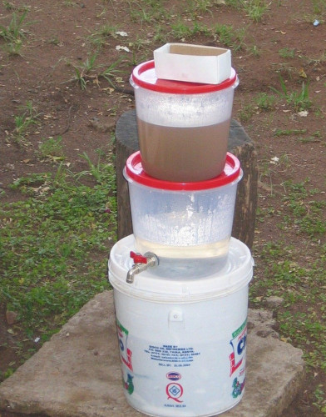
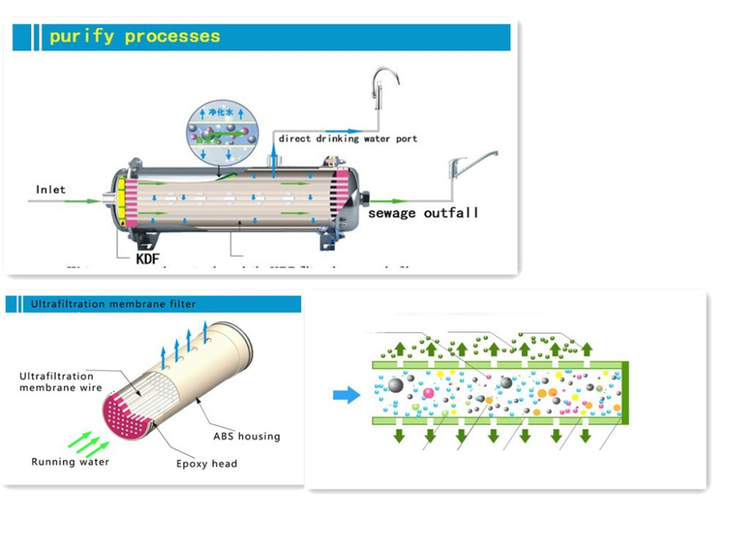
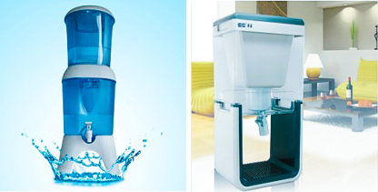
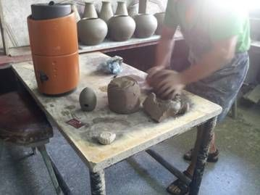
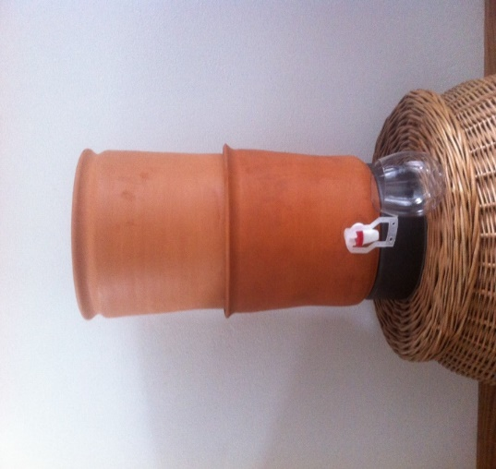
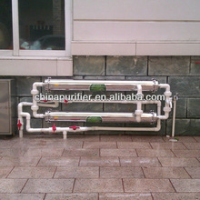
Membrane solution for schools, hospitals, households
Basic Cost 100 – 3000 euro capacity 300 – 4000 liter/h
Gravity water purifier:
25 l/d
Cost Simple local assemble
10-25 euro
Designed 25 -100 euro

Slide 8
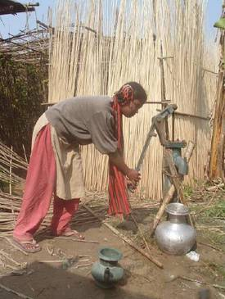

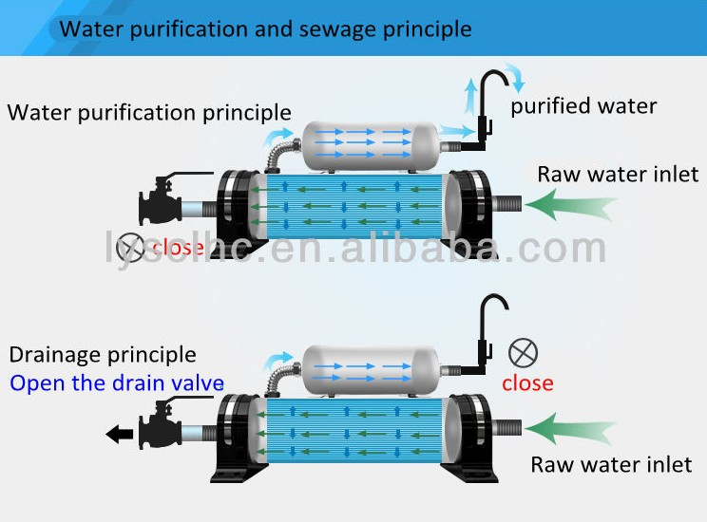
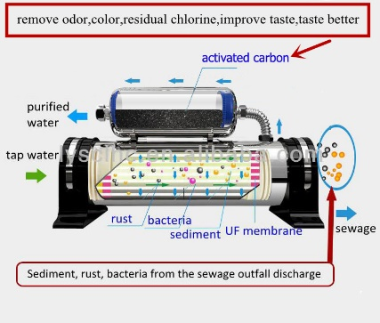

Slide 9

Activities for Romania:
  Help local workshops to make / assemble good quality water filter units.
  We strive to establish a local trading group that will either import filter candles of the required high quality. Or the group purchases the candles from a high quality local manufacturer. This trading group can subsequently also provide a lasting after sales service and monitoring of filter candles.
  Target groups are Schools, Health Centers and Households. Water4life strives for quality and affordable prices for the target poor people.
  Ngo's give training programs
  1) Lessons / trainings for school children:
  Program children teach the parents
  2) Training / promotion program for hospitals and local family doctor.
  3) programs for entrepreneurs and future users of the
  water purifiers to create awareness about sanitation
  hygienic the dangers of drinking unsafe water and the
  advantages of the use of the water purifiers.

Slide 10


Thank you for your attention

