Slide 1


Slide 2
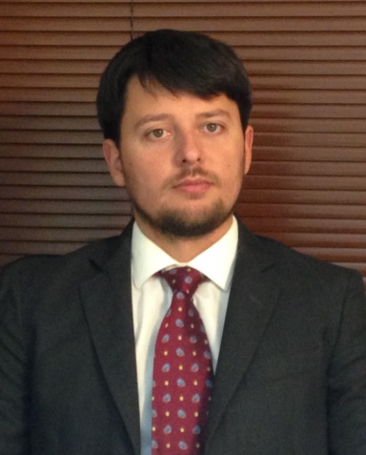
Projects and activities
Alexandru Stoian
Dentist – Orthodontist.

Slide 3
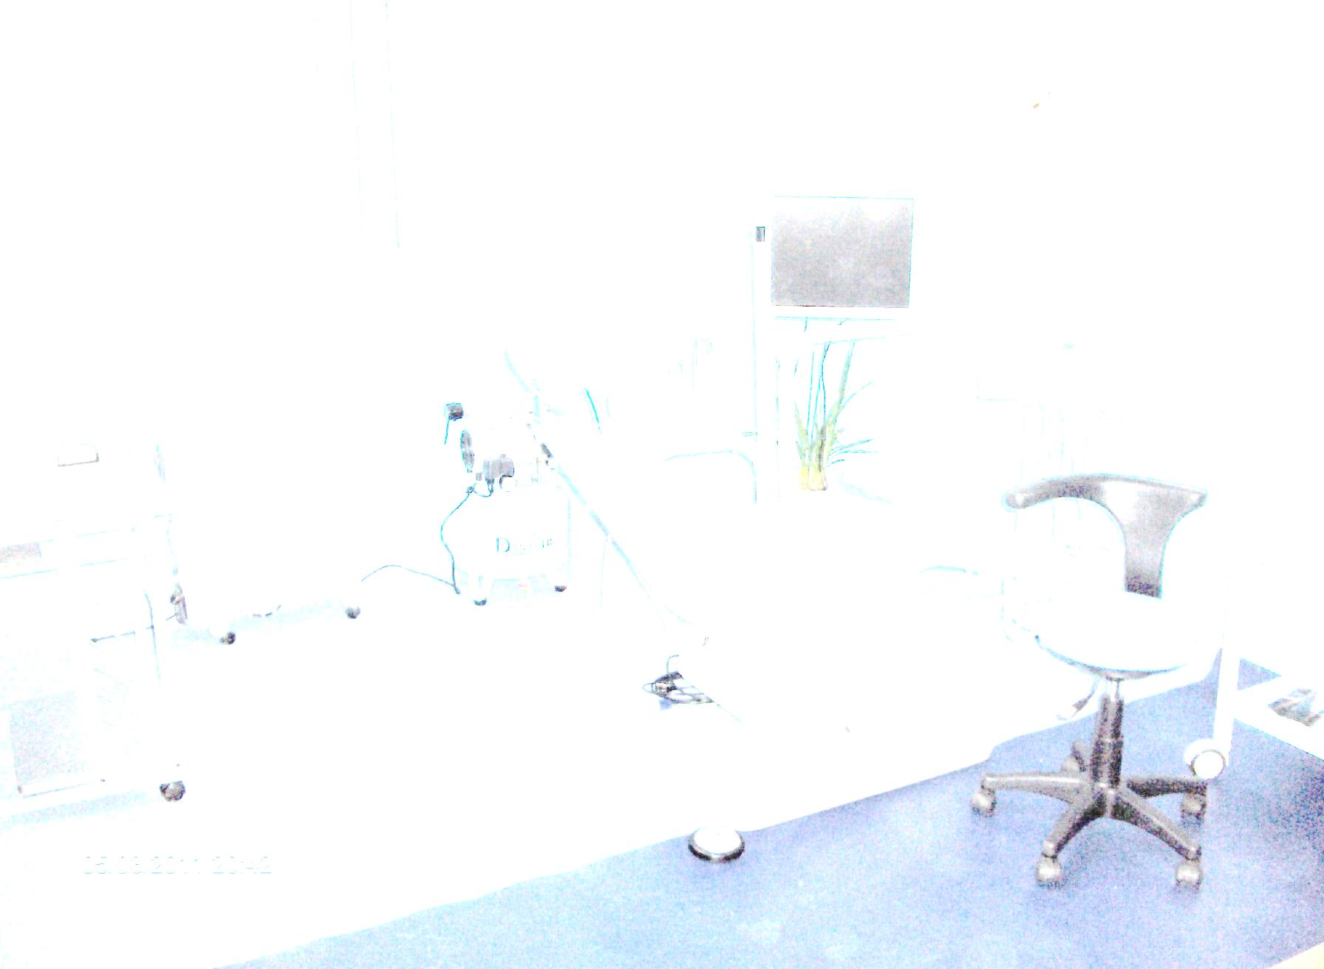
Studies
Graduated Dental Faculty UMF Carol Davila Bucuresti
Graduated the Master in Dental Implantology
2014 Became specialist in Orthodontics
Projects
2011 Dental consulting room Cernisoara
2011 Collaboration with Dental consulting room Bucharest
2013 Ngo Asociatia medicina in folosul pacientilor
2014 Dental consulting room Lapusata
2014 Dental consulting room Ramnicu Valcea
2014 Contract with CJAS for Cernisoara
2014 Collaboration with Dental consulting room Tandarei – Ialomita
2015 Joined TON

Slide 4

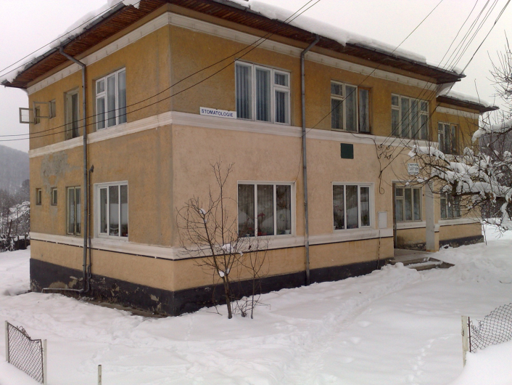

Slide 5
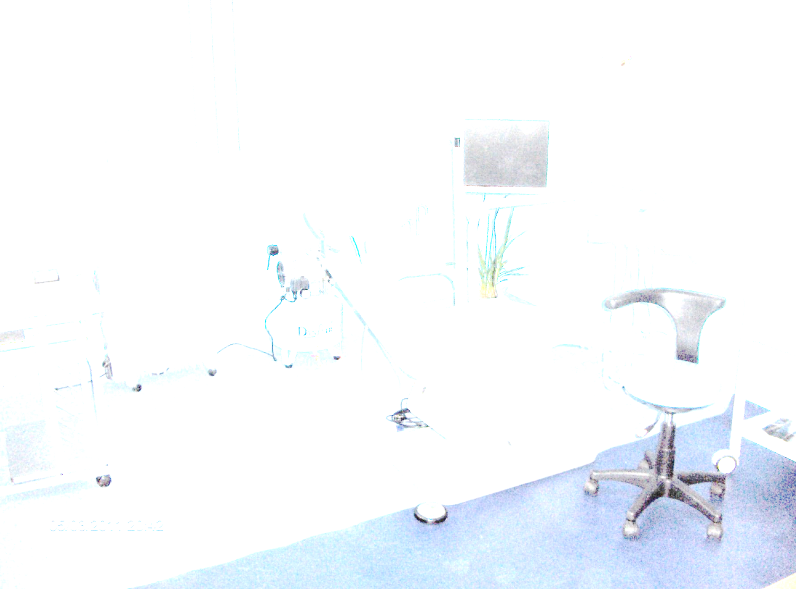

Slide 6
How it started
In November 2010, the mayor of Cernisoara and I, started a partnership to have a dental services in his commune;
He offered the old dentistry consulting room and some good willing people to help;
I had to bring the necessary instruments and to refurbish the place;

Slide 7
How it started (cont.)
I bought a second hand chair from an older dentist;
I also bought an air compressor and an autoclave;
The same with the furniture ( the sink and it’s cabinet , a table and cupboards to deposit the materials );

Slide 8
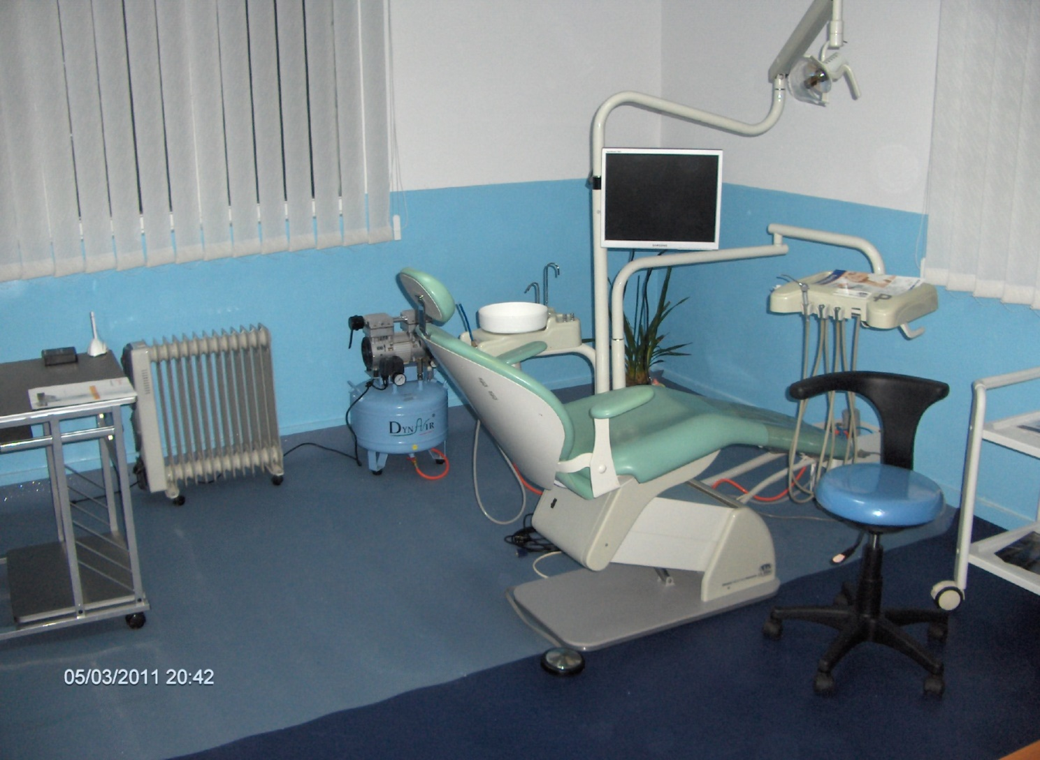
The results since March 2011

Slide 9
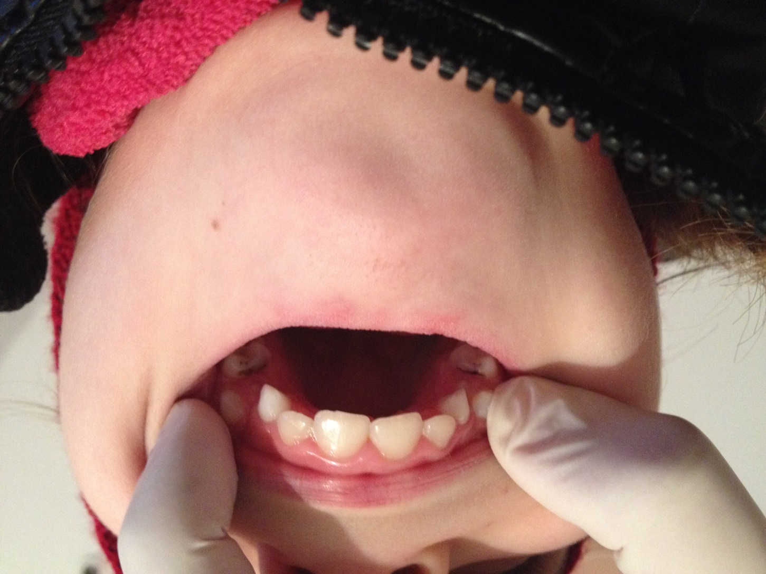
First patients

Slide 10
Next steps
As you know , in the countryside there are big problems with income so a lot of people are having difficulties affording dentistry services
I took care of children, old people, handicapped people and people not able to pay for normal dental services
For this purpose I created an NGO:
“Medicina in Folosul Pacientilor” (CIF 31661690)

Slide 11

Some papers
S-a cerut autentificarea prezentului înscris:
ACTUL CONSTITUTIV
al asociaţiei
ASOCIAţia „mediciNĂ în folosul pacienţilor”
Încheiat între:
Stoian Alexandru , cetăţean român, născut la data de ………………………, cu domiciliul în …………………………………………………………………………………………………….şi
care se asociază în scopul constituirii, conform Ordonanţei Guvernului nr. 26/30 ianuarie 2000 cu privire la asociaţii şi fundaţii, asociaţiei ASOCIAŢIA „MEDICINĂ ÎN FOLOSUL PACIENŢILOR”
Asociaţii au convenit asupra următoarelor prevederi ale Actului Constitutiv:
………………………………………………………..

Slide 12
Next steps
To be able to treat also people that cannot pay the needed fees, the association started a campaign to collect needed funds
I informed my patients about that and also showed them how to donate 2% of their income taxes to an NGO

Slide 13
Results
At the end of 2013 raised more than 4500 Ron which were enough for my special patients
In 2014 a company donated the 2% (2% of 16% income tax they needed to pay that year)

Slide 15
GETTING HELP FROM CJAS
In 2014 the Ministry of health allocated funds for dental medicine , in order to get I made a contract with CJAS.
To get them the dental office had to reach some imposed standards and the dental office in Cernisora meet them
Right now, the dental cabinet gets 2000 Ron/month from CJAS Valcea.

Slide 16
Prevention and rural medical services
With the support of CJAS – they pay 100 % of the national established price of many services – I started a prevention project
The basic prevention to be done is dental sealing and teeth filling of temporary teeth
My target age was 5-8 years children
I informed the school directors (2 schools in Cernisoara) and the kindergarten instructors
They sent groups of 20-30 children of which we made a consultation at first and then started with the most difficult cases the treatment

Slide 17
This is how the program works :
Select patient by name
Select category of patient
Select service need to be done (some services are 100% reimbursed by CJAS (under 18 years old and some services for adults) some are less – you can notice this in the red boxes )

Slide 18
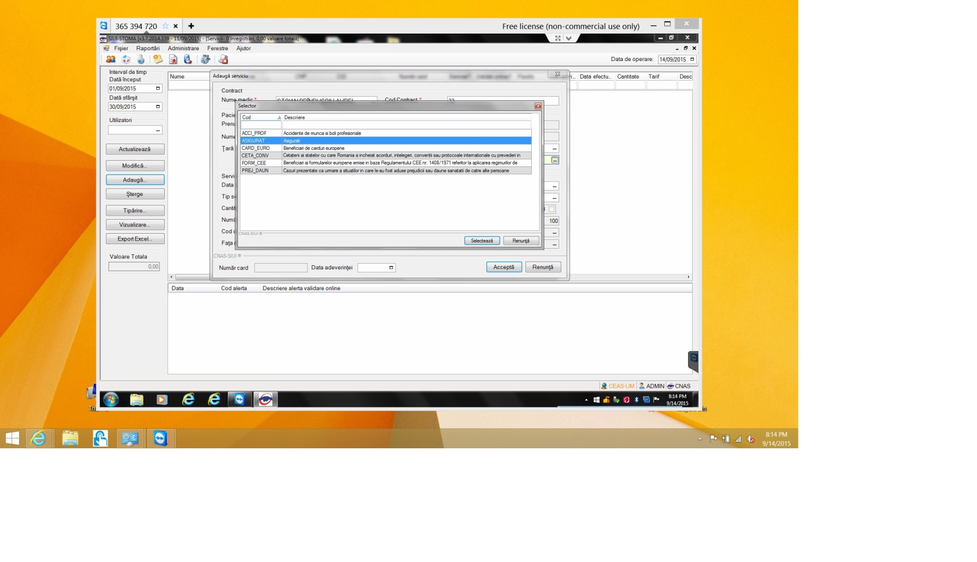

Slide 19
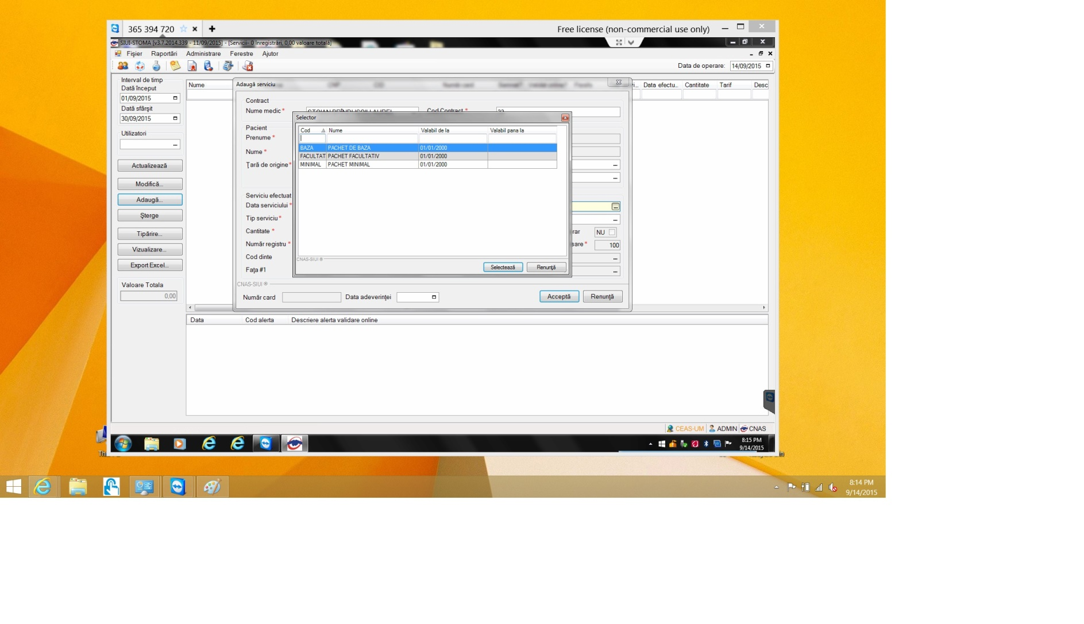

Slide 20
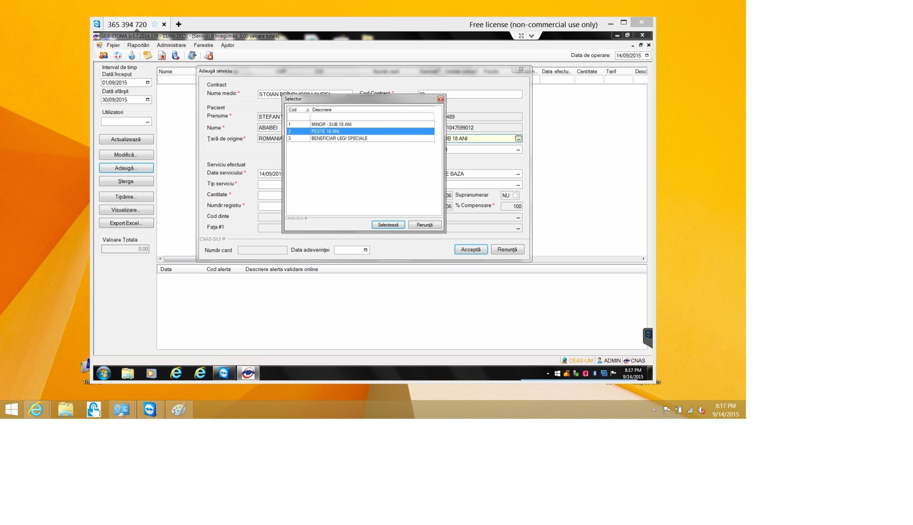

Slide 21
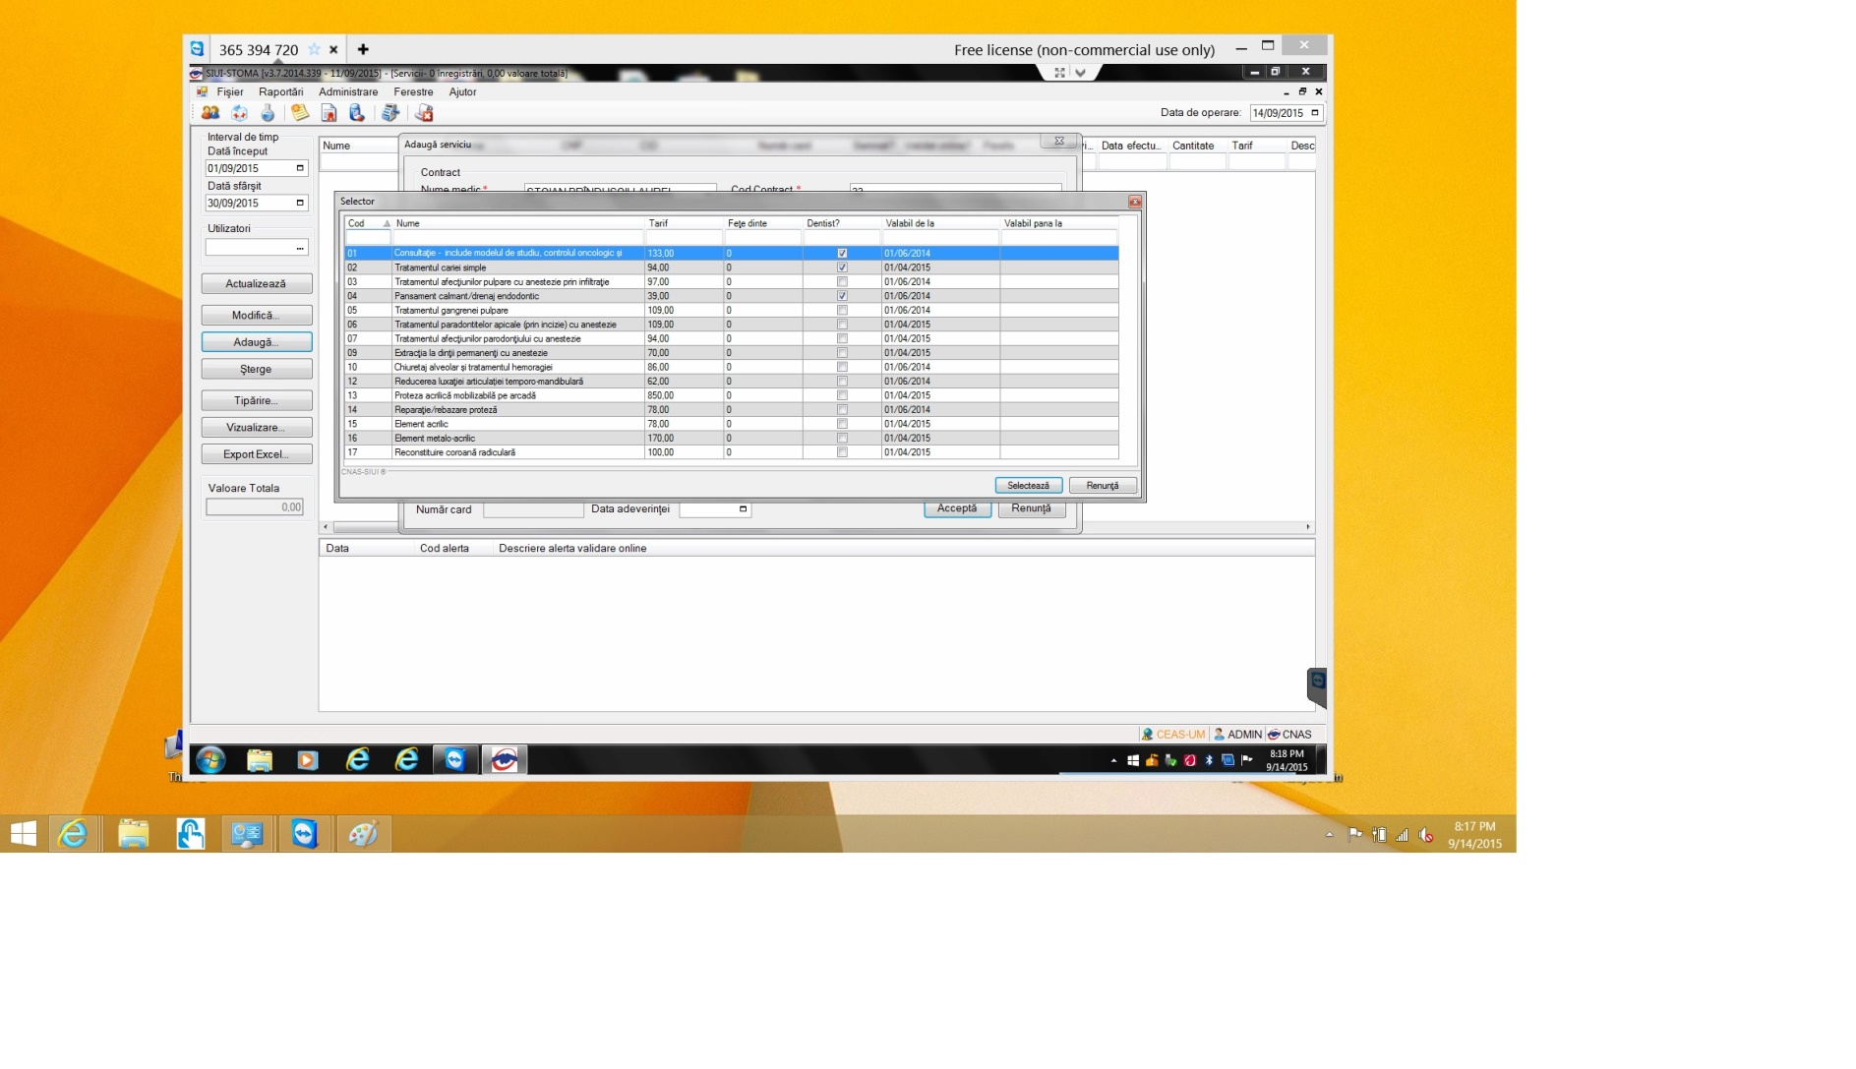

Slide 22
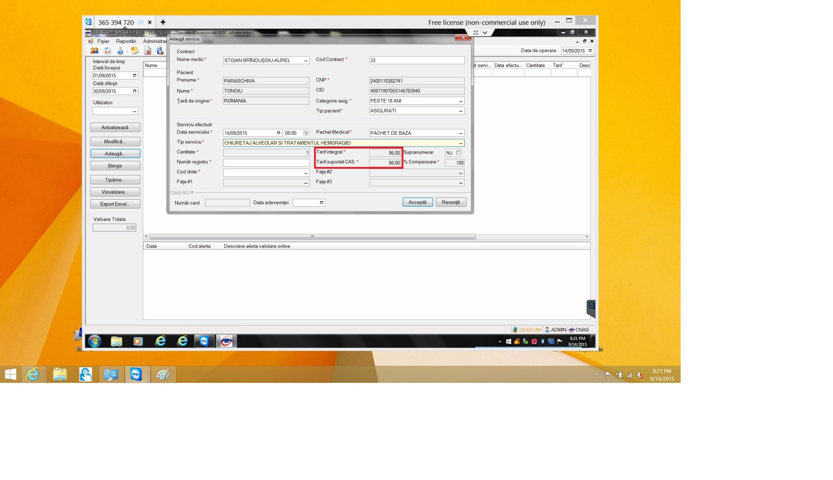

Slide 23
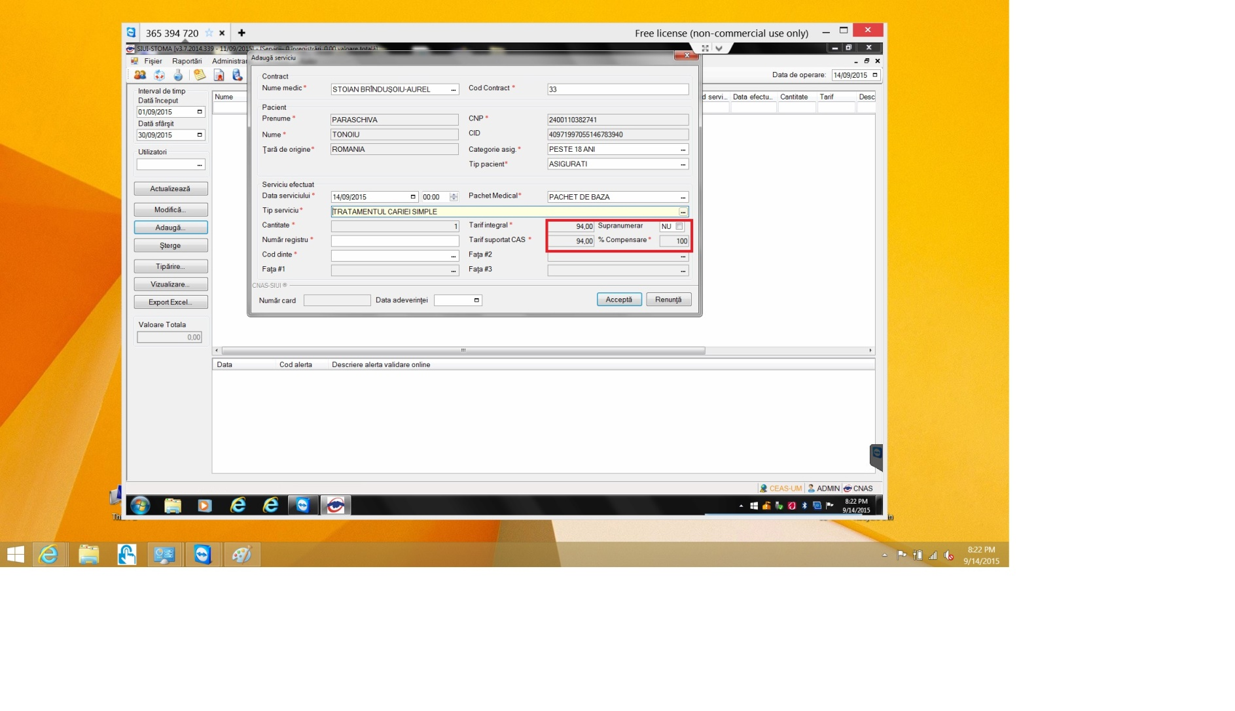

Slide 24

Future
Continue the program and recruit new doctors
Join a bigger system like TON

Slide 25
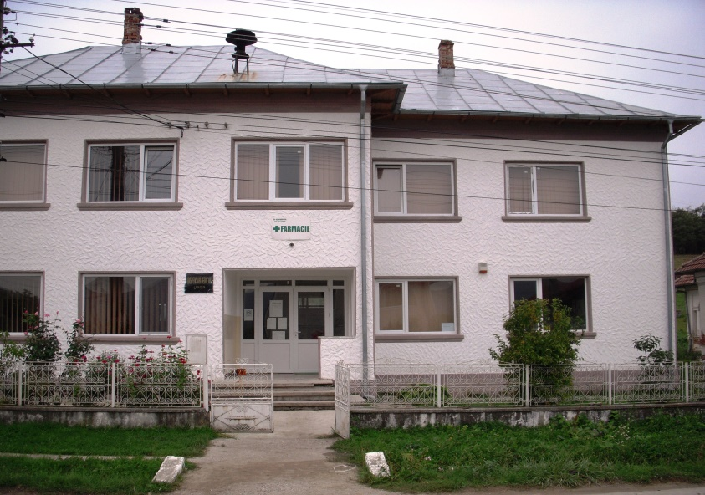
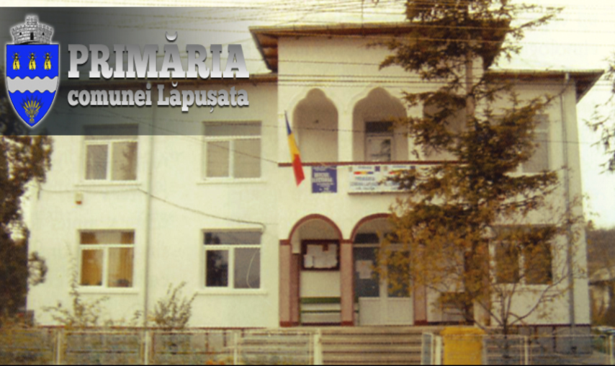
Lapusata 2070 inhabitants

Slide 26
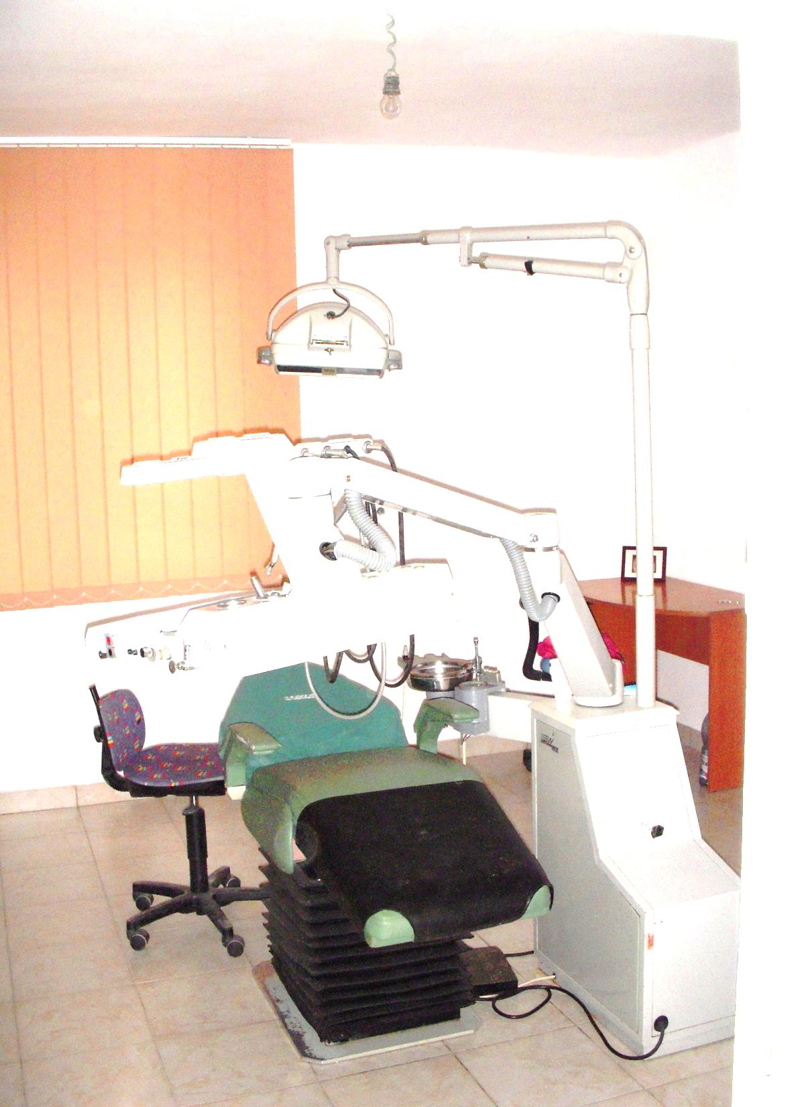
First steps in Lapusata
With the help of the mayor of Lapusata and the experience from Cernisoara we started refurbishing the old dental cabinet of Lapusata at the beginning of 2014
We repaired the ceiling, the wall and the floor
I bought a dental unit, a sterilization poupinel and medical furniture
The Mayor also renewed the outer part of the building

Slide 27
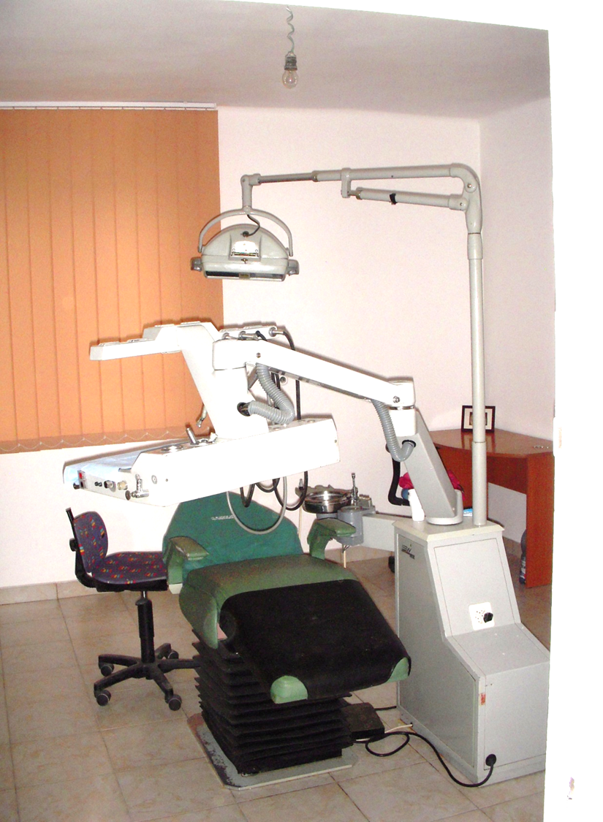
We informed the people
At the beginning few patients came
After 1 moth there were 30 patients for a day
Because I can go there only once a week I had to find a dentist to help me .

Slide 28
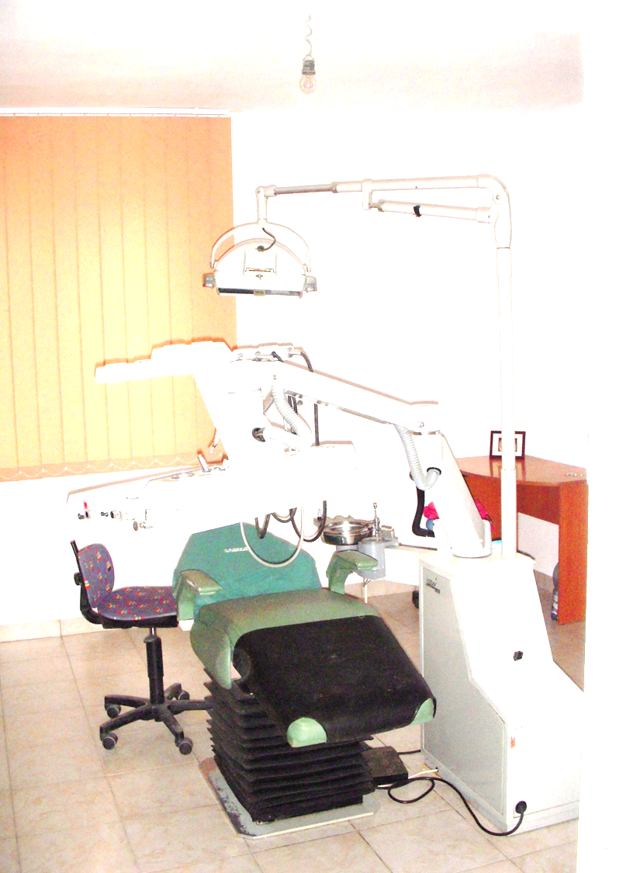
Prevention
Being helped by the English teacher from the primary school of Lapusata we organized consultations for all the children in the school
The ones with the most severe problems came the first to be treated
CJAS allows only one contract per person so I am forced to declare the treatments from Lapusata as treatments made in Cernisoara so some of the children from there can get state help too

Slide 29
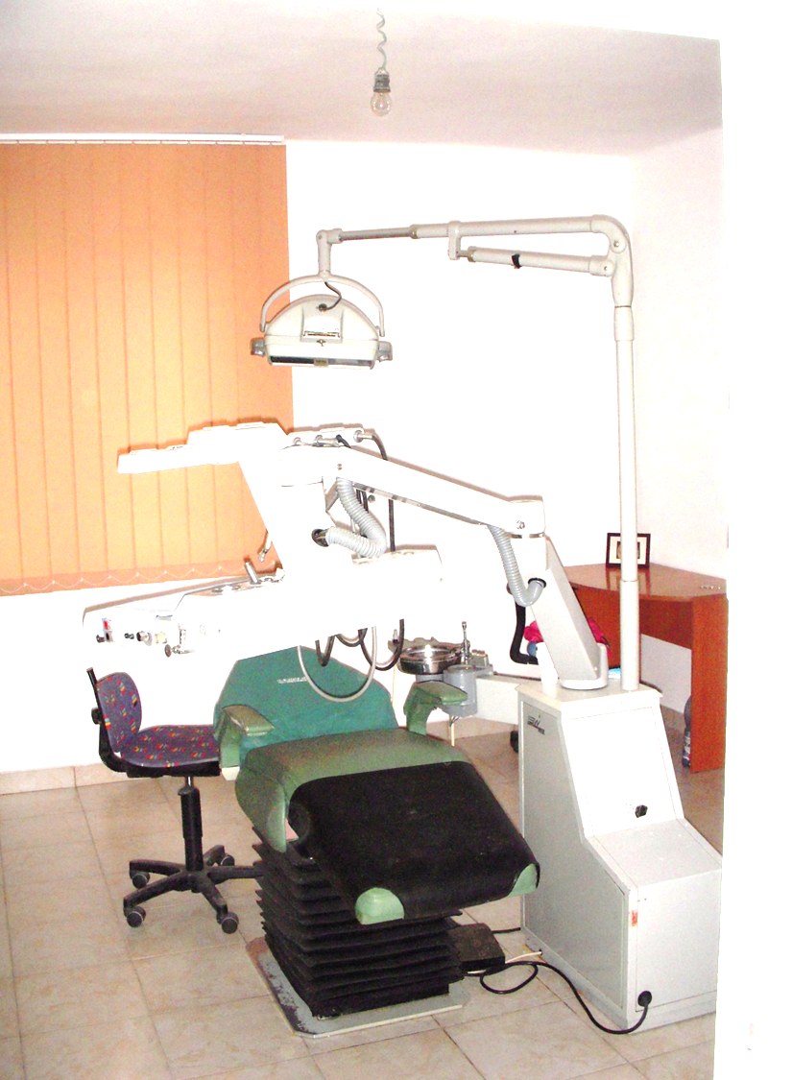
Future plans
Get European funds and to improve the medical equipment and conditions
Get the dentist that is helping me to sign a contract with CJAS so we can get funds for Lapusata too.

Slide 30
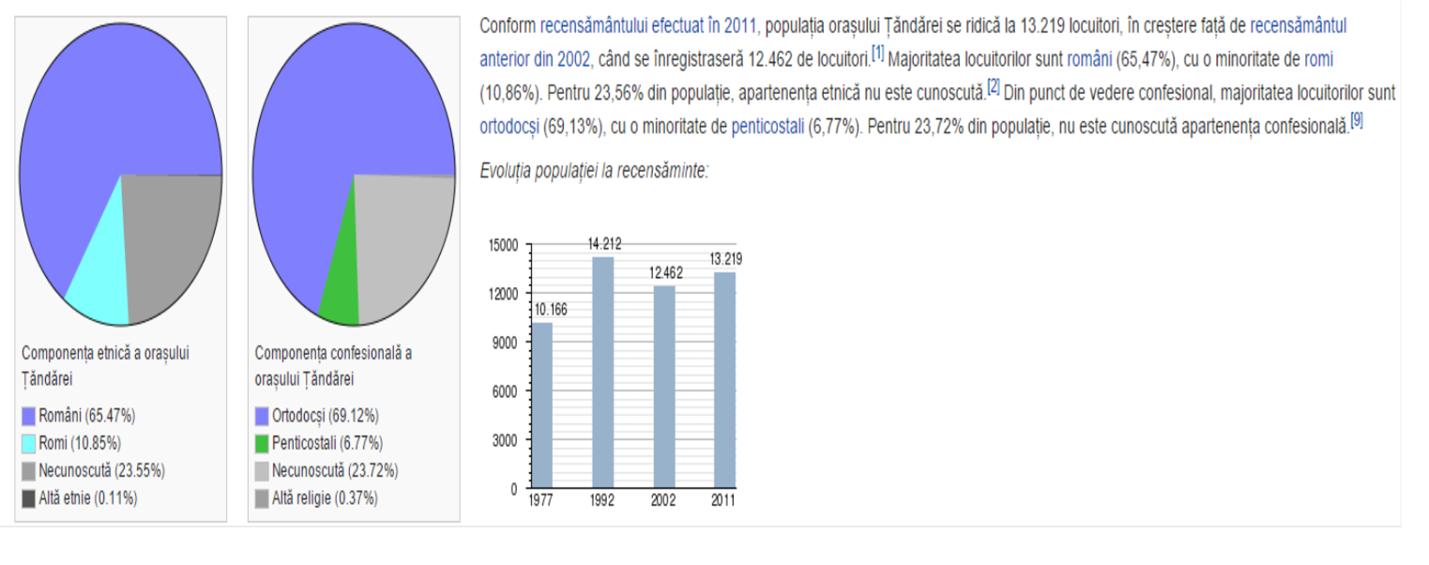
Tandarei Ialomita
13000 inhabitants in 2011

Slide 31
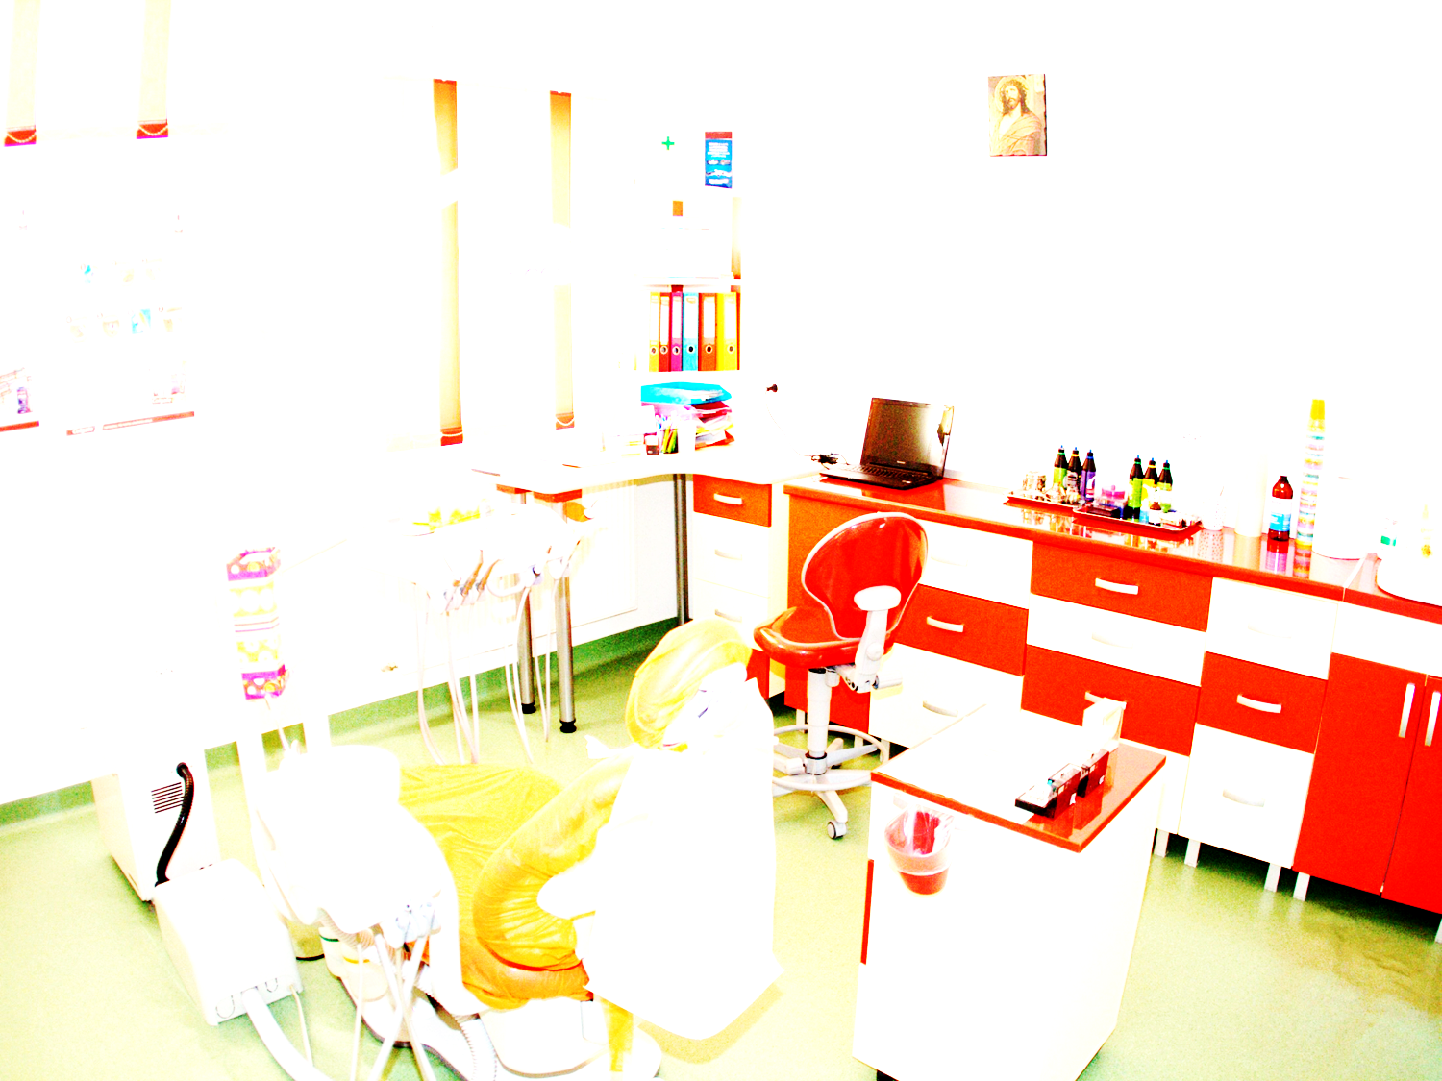
First steps in Tandarei
In 2014,my colleague Grecu Indira decided to go and work as a general dentist in Tandarei Ialomita
They had no orthodontist so I decided to go there once a month
We also found a oro-maxillo-facial surgeon to come there and help

Slide 32
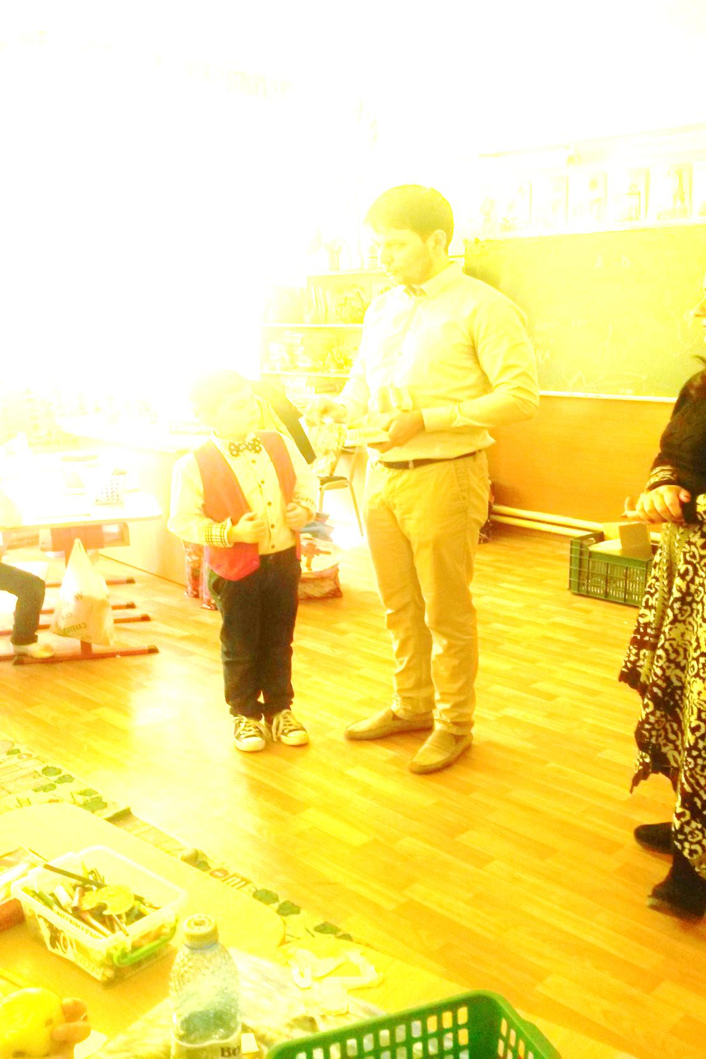
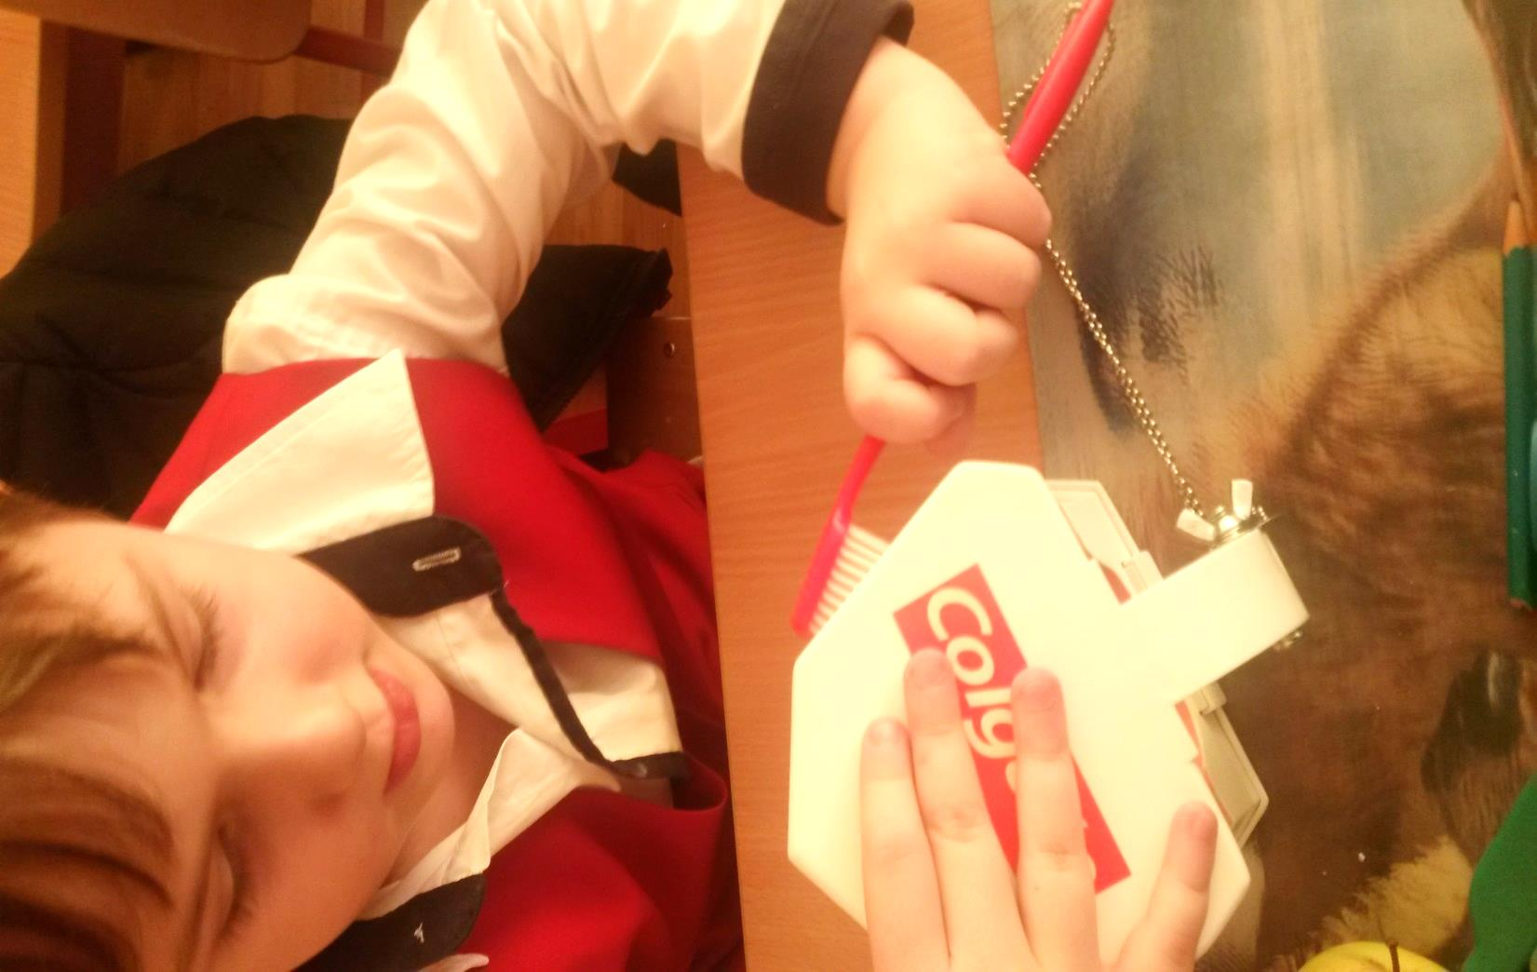
Prevention program in Tandarei
We went to the local schools and taught children basic rules of oral hygiene.
In the following weeks they also had free consultations
The dental office has contract with the CJAS so some of the treatments could pe covered by the state

Slide 33
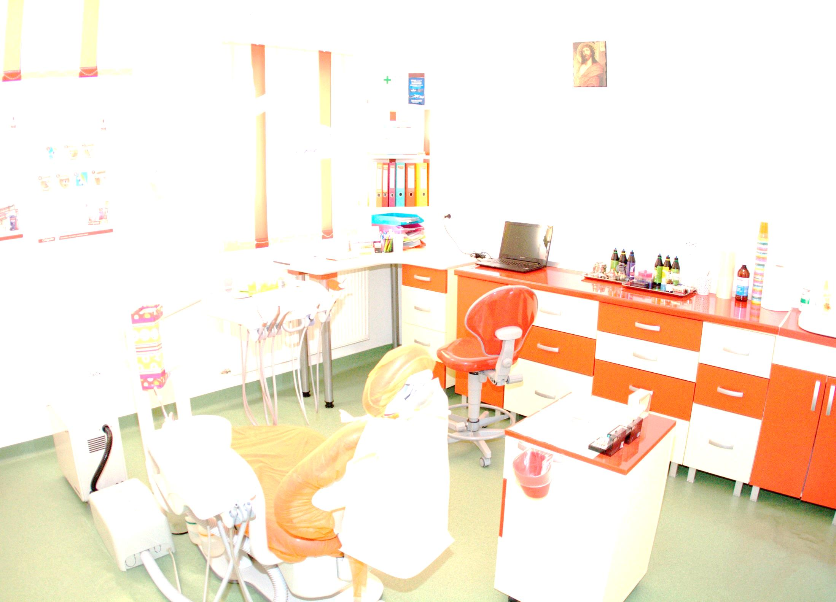
Future plans in Tandarei
Bring other medical specialist as cardiologist , gastroenterologist, pediatrician

Slide 34
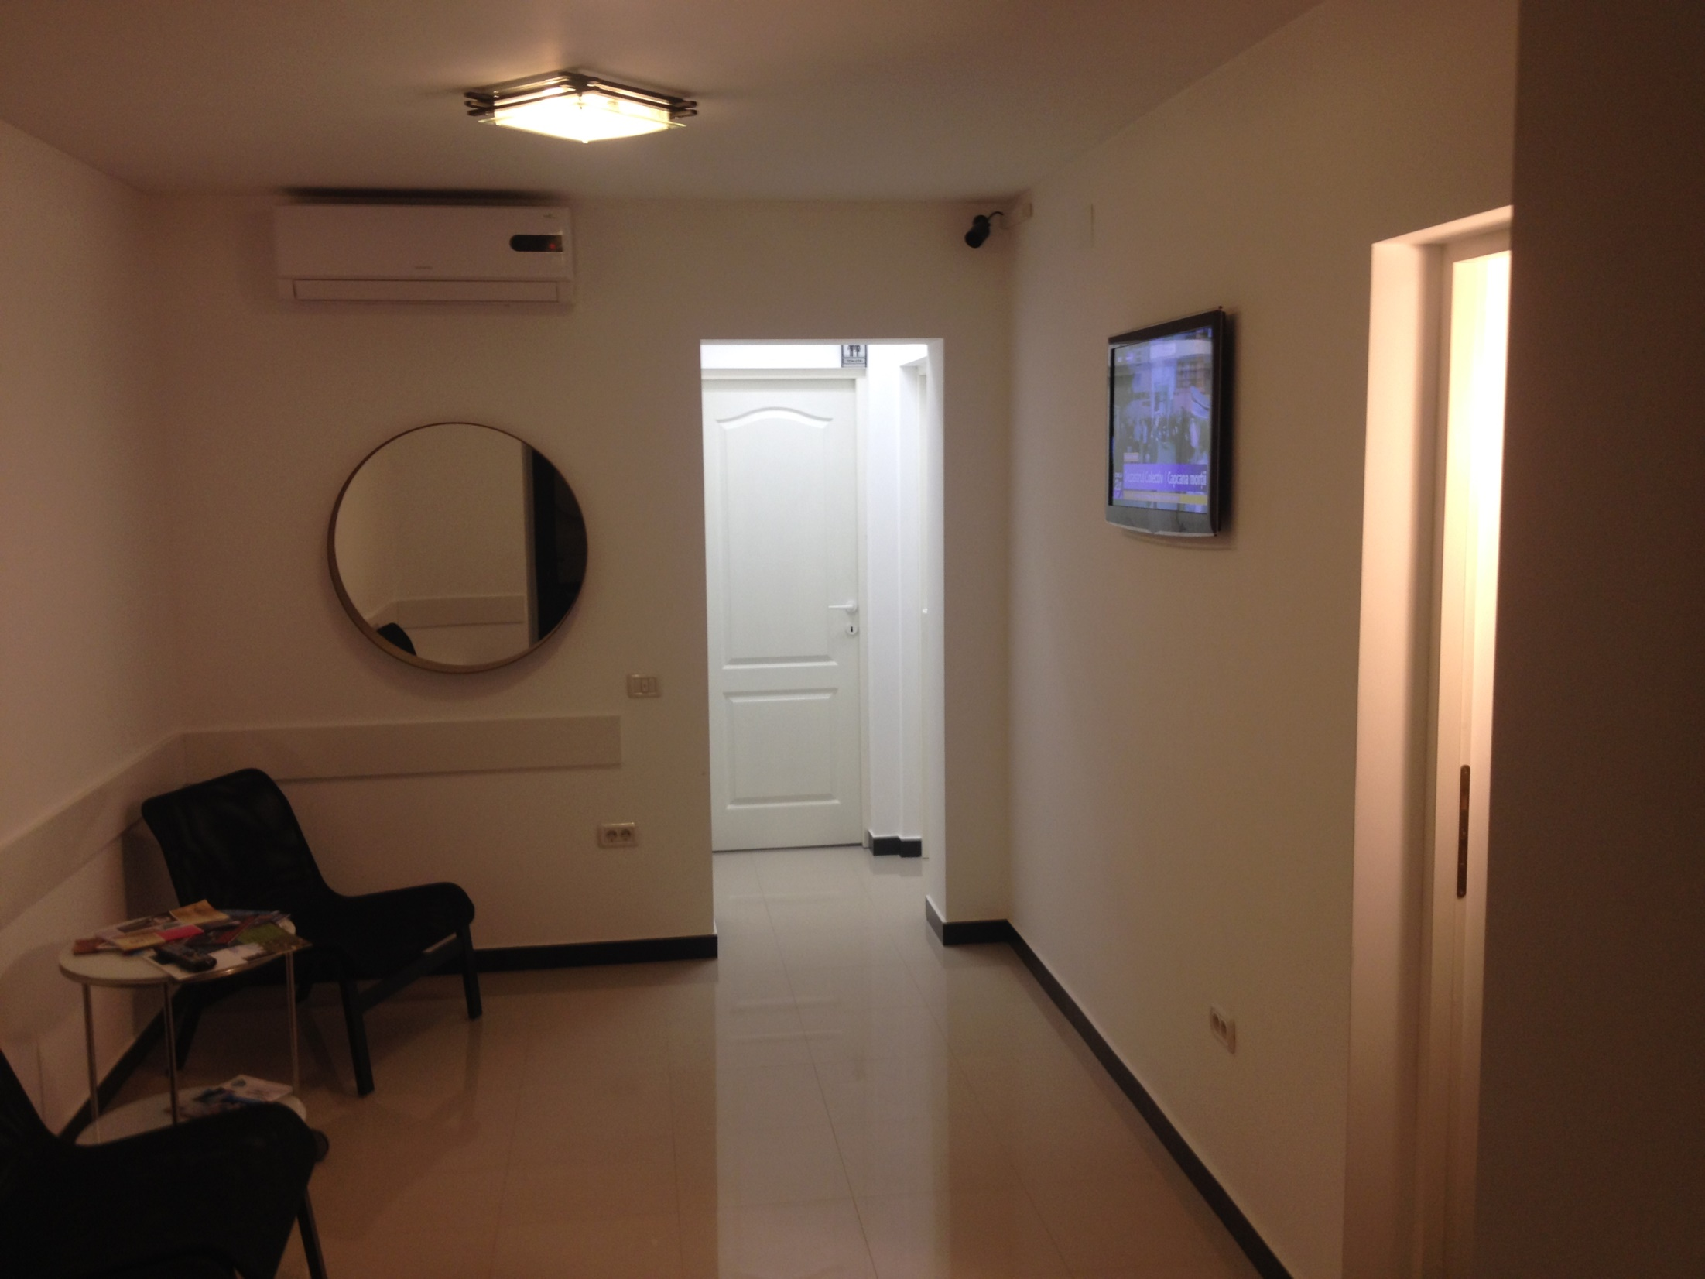
Prevention in Bucharest and Ramnicu Valcea
We take care about recently erupted teeth by tooth sealing
We also look for interception of orthodontic problems
Periodical dental check

Slide 35
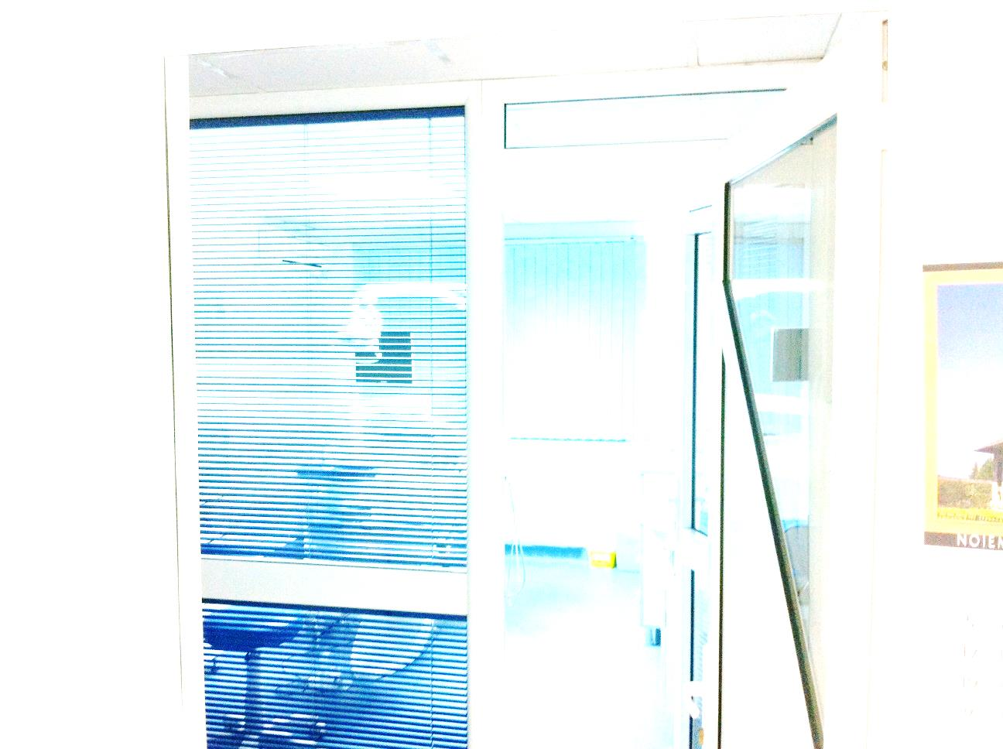
In the urban places everyone benefits from preventive dentistry. Children in particular benefit because it allows their newly developing adult teeth to come in strong and healthy. Aging adults benefit from preventive dentistry because it helps them to keep their real teeth.

Slide 36
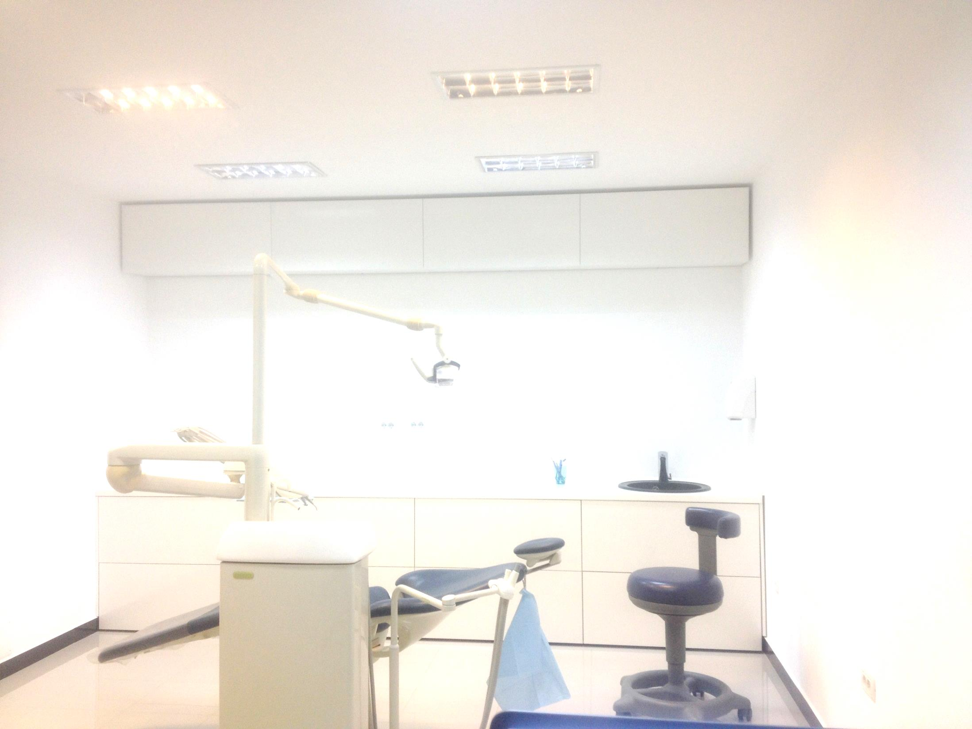
There are many forms of preventive dentistry, such as daily brushing and annual dental cleanings. These practices are designed to ensure that teeth are clean, strong, and white. Children should be taught proper oral hygiene at an early age.
The most important part of preventive dentistry is to brush teeth daily with fluoride toothpaste. Most people should replace their toothbrushes three to four times a year or as the bristles start to fray.
Ramnicu Valcea

Slide 37
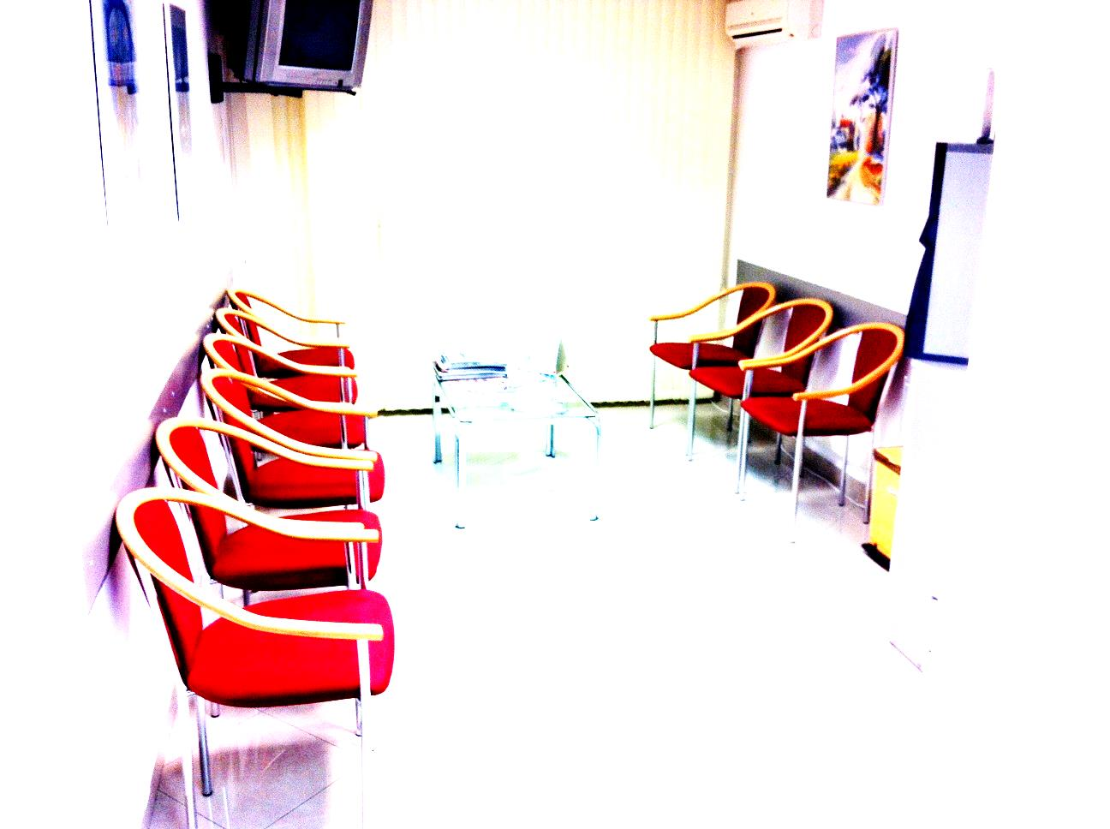
Thank you !

Slide 38

`

